Slide 2
Computational approaches for the therapeutic target discovery to ame-liorate muscle wasting during aging and disease
Msc Karen Guerrero Vazquez
Dr. Katarzyna Whysall
Dr. Pilib O Broin

Slide 3






Slide 4
~3 – 8 %
Loss of muscle mass per decade
Brocklehurst, 1976
Notes:
. From the time you are born to around the time you turn 30, your muscles grow larger and stronger. But at some point in your 30s, you start to lose muscle mass and function. No matter the lifestyle, everybody is going to loss between 3 to 8% of muscle mass per decade after age 30, and this rate of decline is even higher after the age of 60. Sarcopenia is associated with detrimental clinical outcomes, such as a reduced quality of life, frailty, an increased risk of falls, fractures, hospitalization, and mortality.

Slide 5
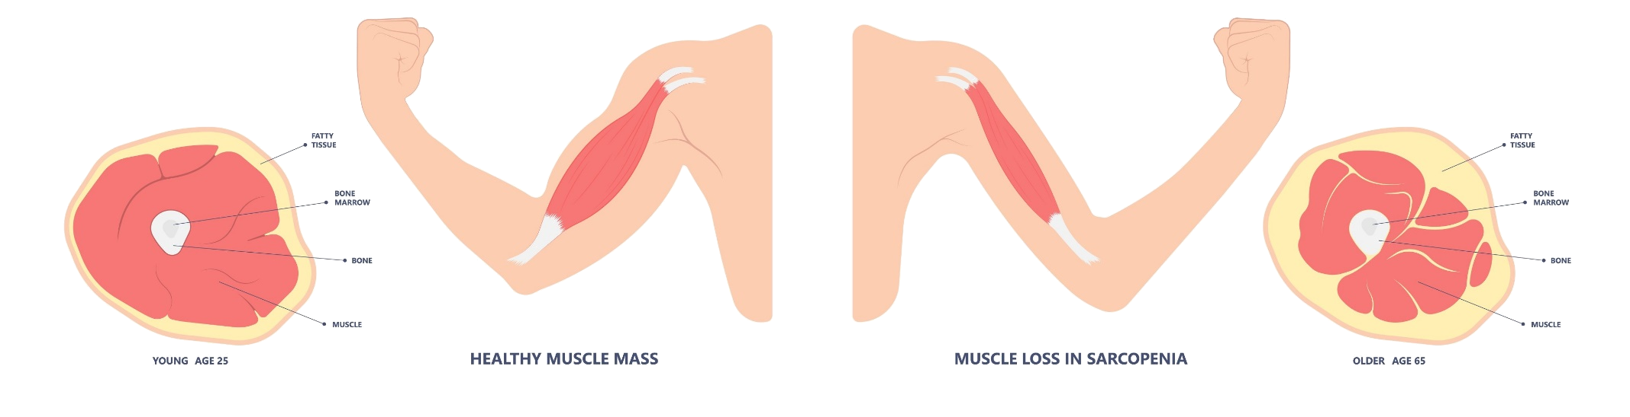

Slide 6
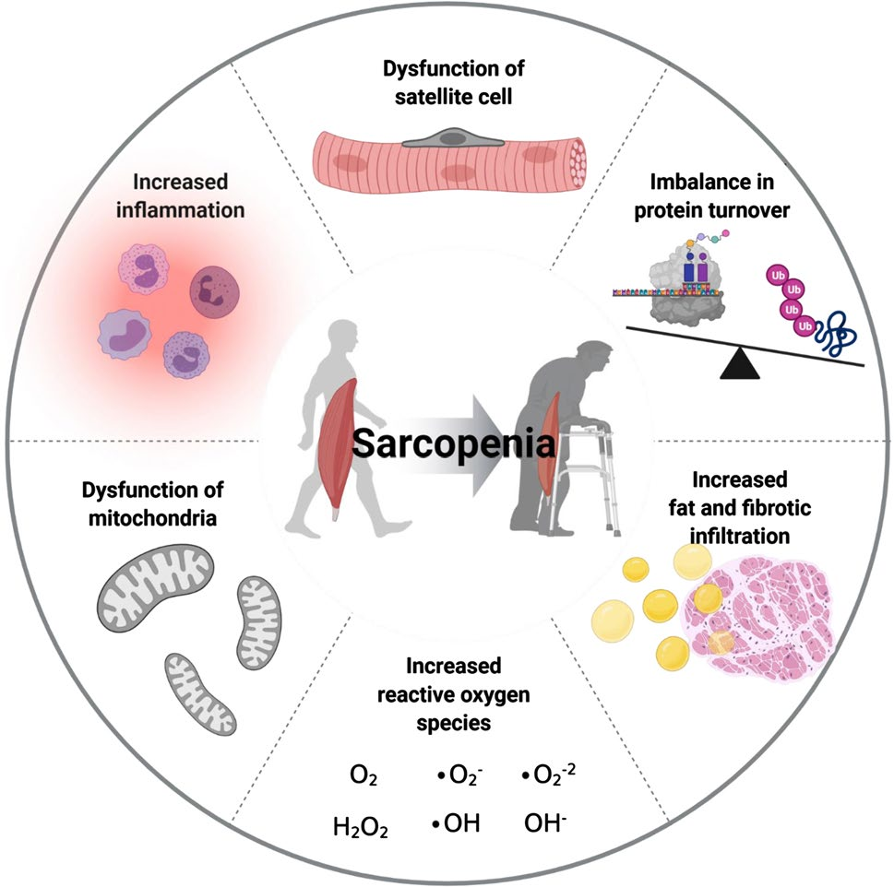

Slide 7
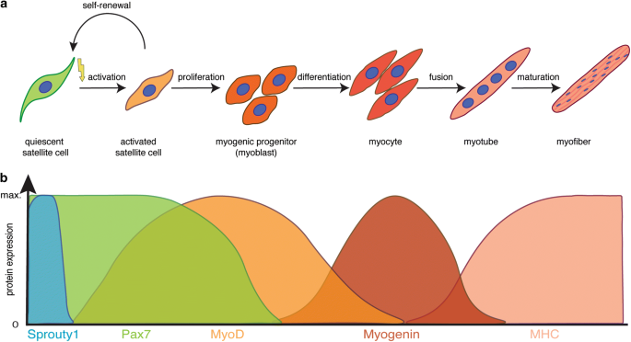
Muscle Regeneration

Slide 8
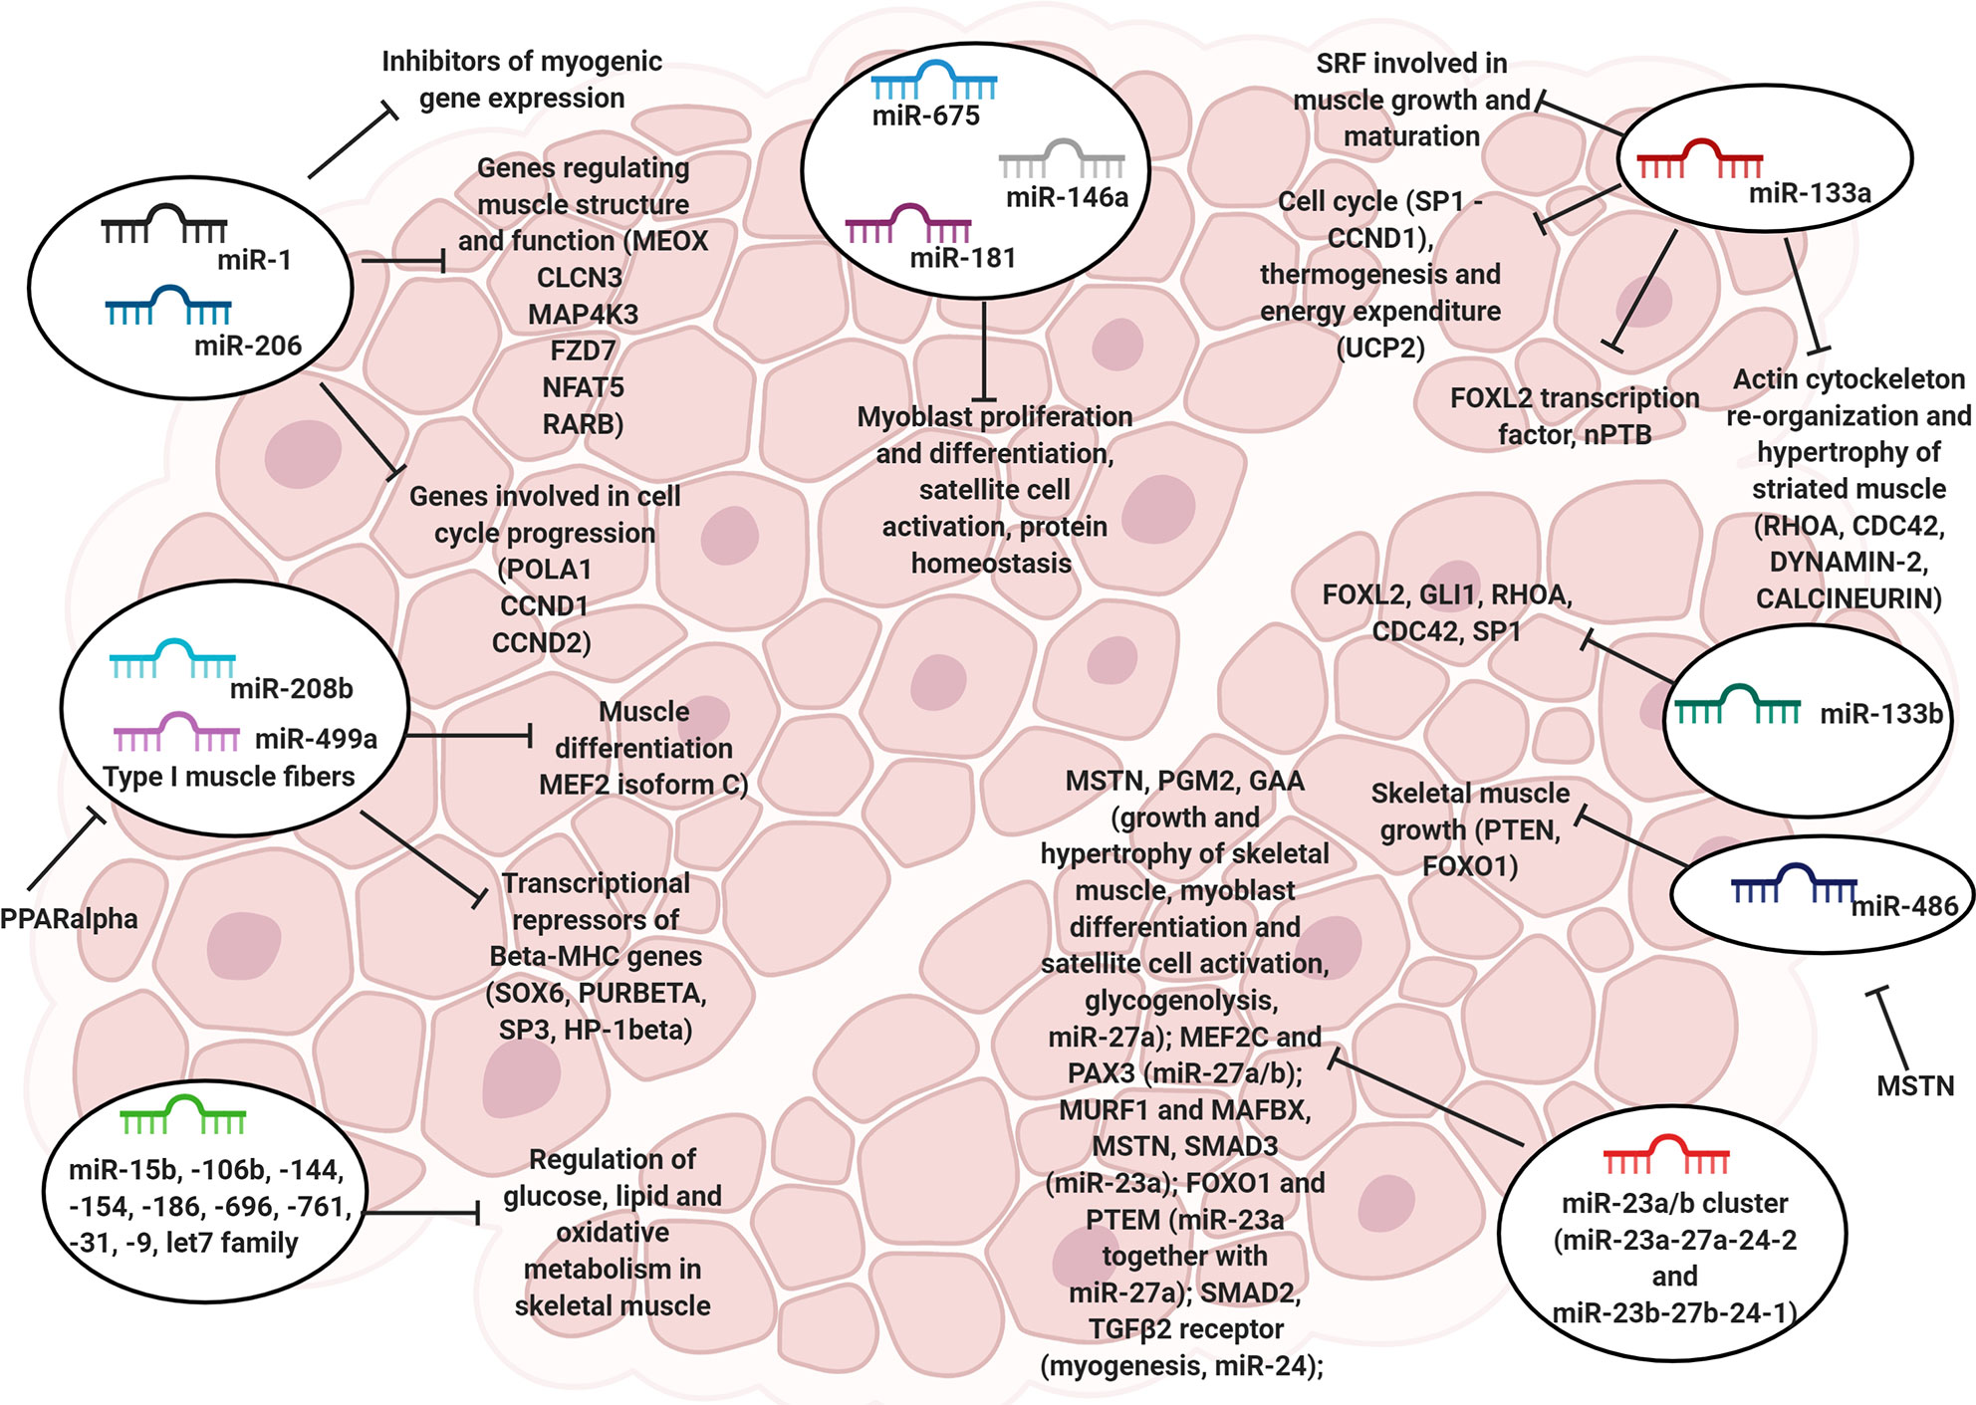

MicroRNA (miRNAs)

Slide 9
miRNAs
mRNA
~1200 nt
miRNA
~28 nt
491,400 permutations
miRNA seed
~ 5 nt
120 permutations
The probability of any given seed to bind to at least one part of the mRNA is
91.33%.

Slide 10
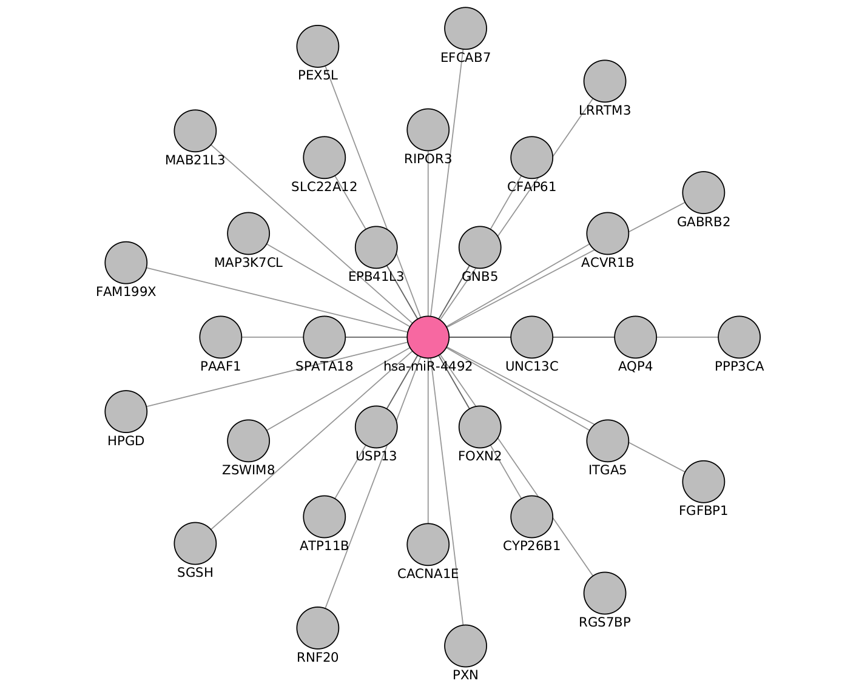
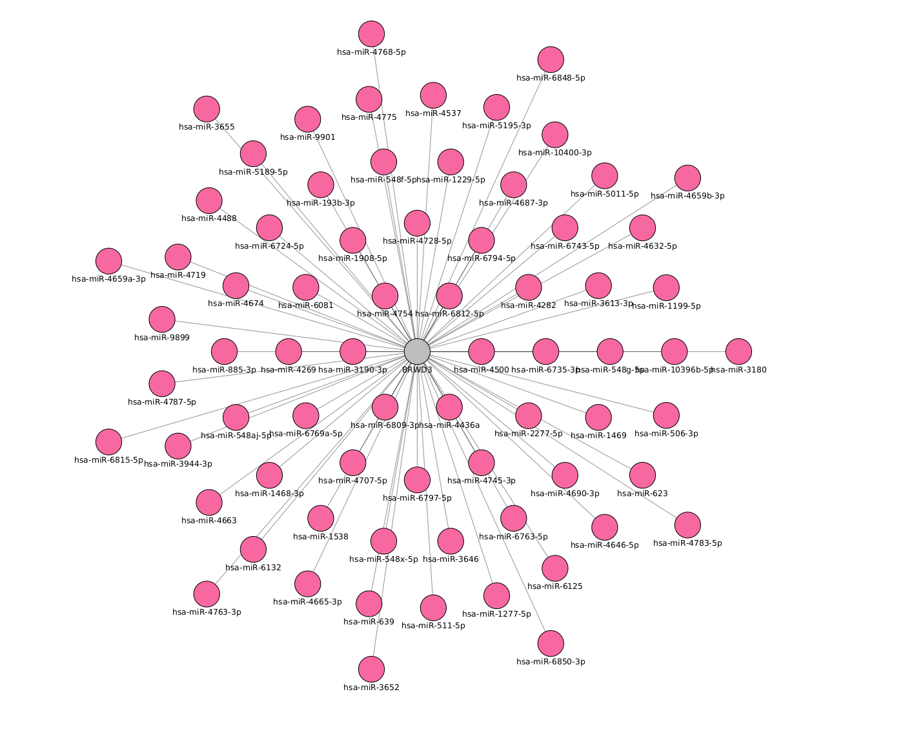
miRNAs
Notes:
miRNAs are often ubiquitously expressed, have overlapping functions and can regulate multiple genes. Also, not all miRNAs are functionally relevant in a given cell type.

Slide 11
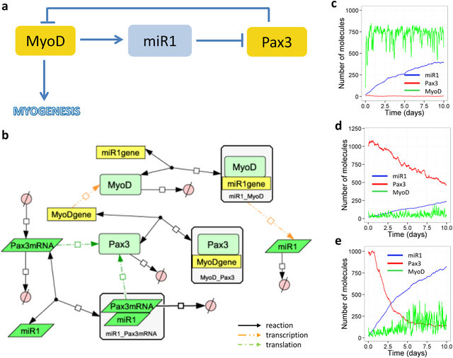
Carole J. Proctor & Katarzyna Goljanek-Whysall, 2017, Using computer simulation models to investigate the most promising microRNAs to improve muscle regeneration during ageing

Slide 12
Chapters
Differential analysis: muscle during time
MiRKat DB; An integrated database for microRNAs
miRKat; Algorithms for the selection of microRNA targets
Bonus:
Execution of selected microRNAs in vitro (?)

Slide 13
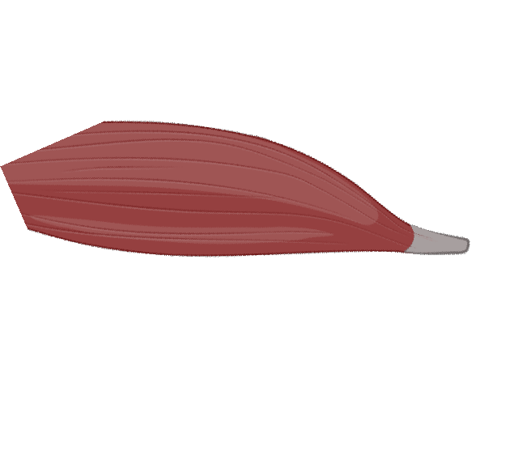
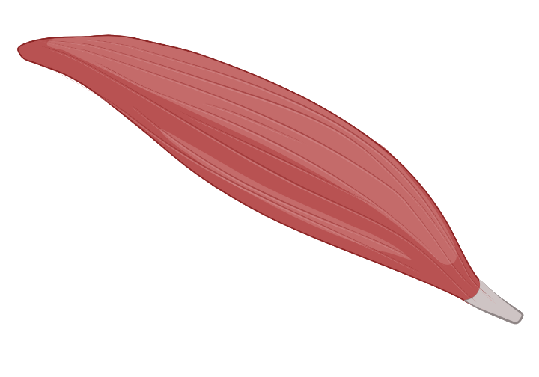
Differential analysis: muscle during time

Slide 14
My Experiments
Target | Type | N. Experiments | Healthy | Non healthy
mRNA | RNAseq | 3 | 3 | 0
 | MicroArray | 4 | 2 | 2
miRNA | MicroArray | 2 | 2 | 0
 | miRSeq | 1 | 0 | 1

Slide 15
Experiments
GEO number | Samples | Min Age | Max Age | Reference
GSE152558 | 5 | 41 | 85 | Tharakan, R., Ubaida-Mohien, C., Piao, Y., Gorospe, M., & Ferrucci, L. (2021).
GSE164471 | 53 | 34 | 80 | Tumasian III, R. A., Harish, A., Kundu, G., Yang, J. H., Ubaida-Mohien, C., Gonzalez-Freire, M., ... & Ferrucci, L. (2021).
GSE157585 | 136 | 19 | >65 | Kulkarni, A. S., Peck, B. D., Walton, R. G., Kern, P. A., Mar, J. C., Windham, S. T., ... & Peterson, C. A. (2020).
GSE87105 | 16 | 30 | 78 | Mercken, E. M., Capri, M., Carboneau, B. A., Conte, M., Heidler, J., Santoro, A., ... & de Cabo, R. (2017)..
GSE23527 | 36 | 29 | 76 | Drummond, M. J., McCarthy, J. J., Sinha, M., Spratt, H. M., Volpi, E., Esser, K. A., & Rasmussen, B. B. (2011)

Slide 16

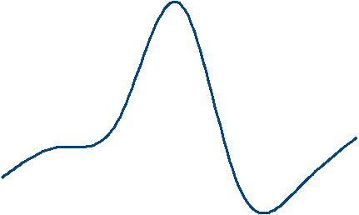
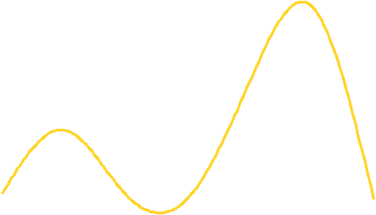
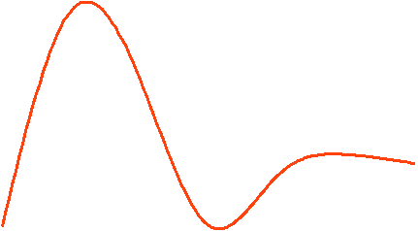
Expression during age
max
Expression
min
20
25
30
35
40
45
50
55
60
65
70
75
80
Age
Figure 2: change of gene expression by age

Slide 17
Notes:
miRNAs are often ubiquitously expressed, have overlapping functions and can regulate multiple genes. Also, not all miRNAs are functionally relevant in a given cell type.

Slide 18
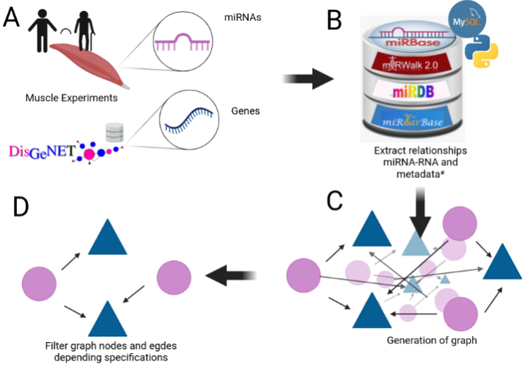
1
1
2
4
3
Notes:
We mentioned that aging have a lot of factors attached to it, in the specific case of Sarcopenia we can include chronic inflammation, increased reactive oxidative species, and increased fibrosis of muscle, among others have been reported to contribute to development of sarcopenia

Slide 19
Expression during age
max
Expression
min
20
25
30
35
40
45
50
55
60
65
70
75
80
Age
Figure 2: change of gene expression by age

Slide 20
Expression during age
Middle age
Old
Young
Y
<35>
MA
<65>
O
Figure 2: change of gene expression by age

Slide 21
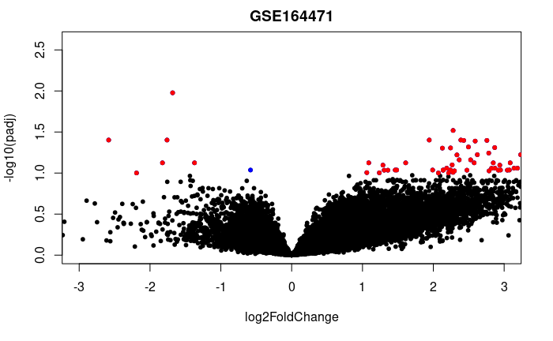

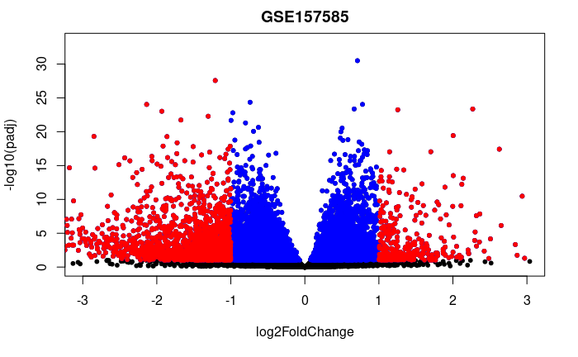
GSE152558
GSE164471
GSE157585
GSE87105
GSE23527

Slide 22
Experiment | Evaluation | Regulation | Genes
GSE152558 | MO | UP | 8
GSE152558 | MO | Down | 9
GSE157585 | YO | UP | 9
GSE157585 | YO | Down | 73
GSE164471 | YO | UP | 5
GSE164471 | YM | UP | 2
GSE164471 | MO | UP | 6
GSE164471 | YO | Down | 8
GSE164471 | YM | Down | 2
GSE164471 | MO | Down | 11
GSE23527 | YO | Up | 1
GSE23527 | YO | Down | 5
GSE875105 | OY | Down | 88
GSE875105 | MO | Up | 6
GSE875105 | OY | Up | 18
Notes:
We mentioned that aging have a lot of factors attached to it, in the specific case of Sarcopenia we can include chronic inflammation, increased reactive oxidative species, and increased fibrosis of muscle, among others have been reported to contribute to development of sarcopenia

Slide 23
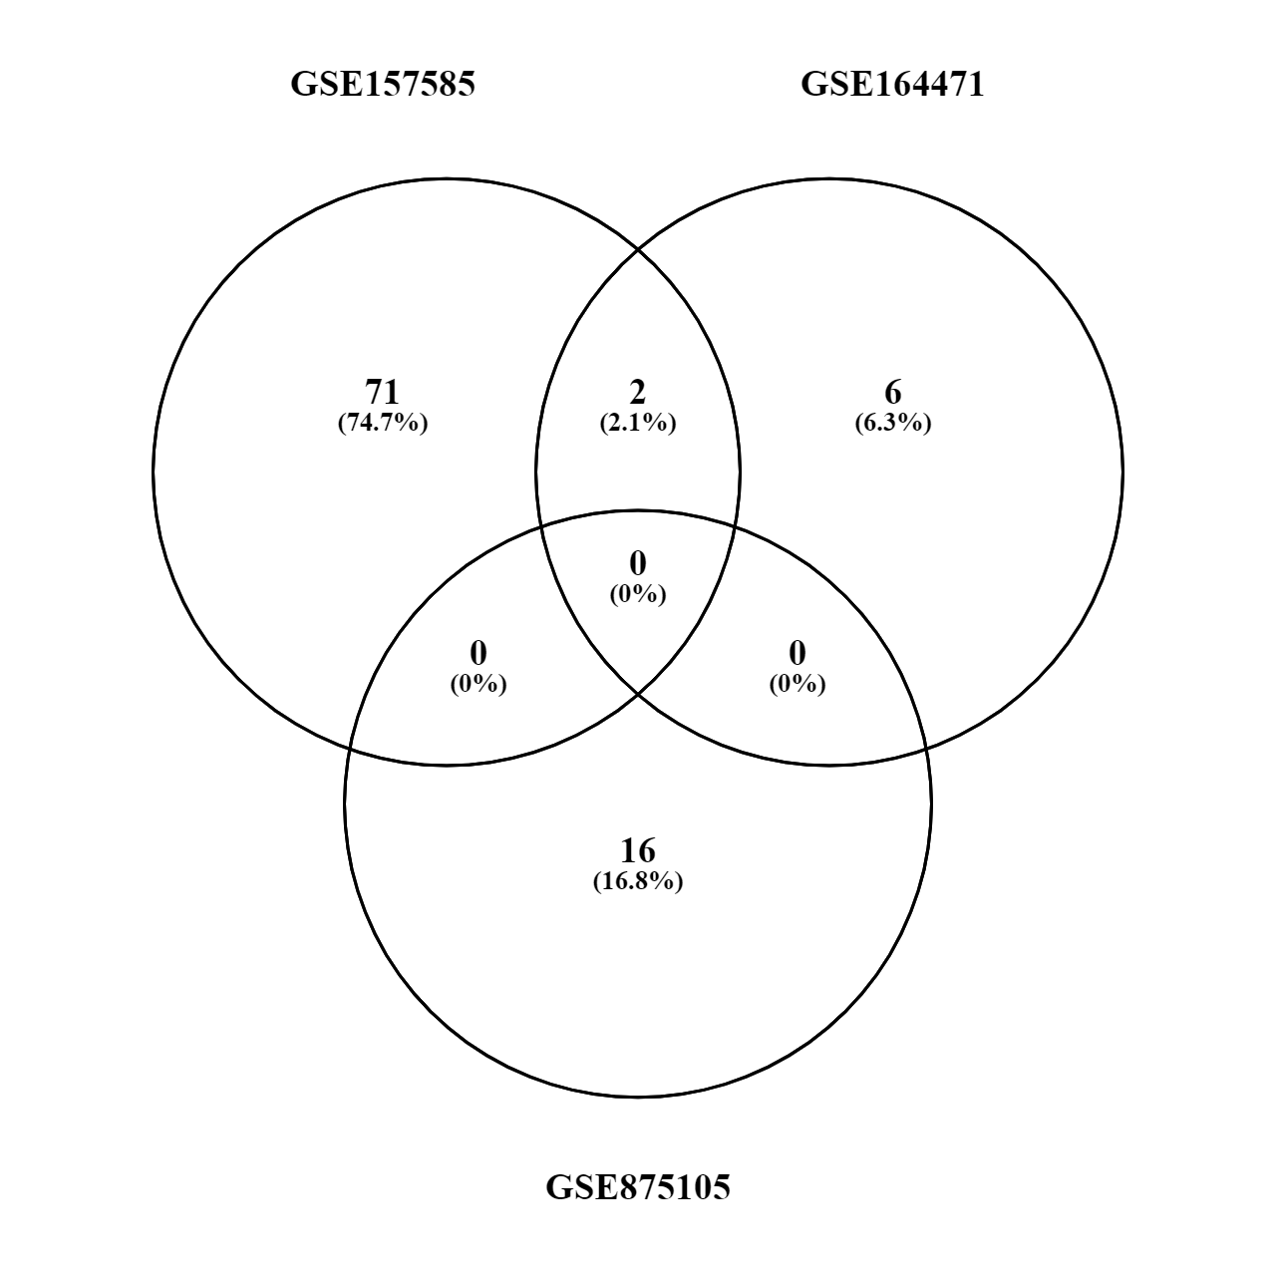
Old vs Young (up or down)
MYH8
HCN1

Slide 24


Tools to obtain the final network

Slide 25



Slide 26
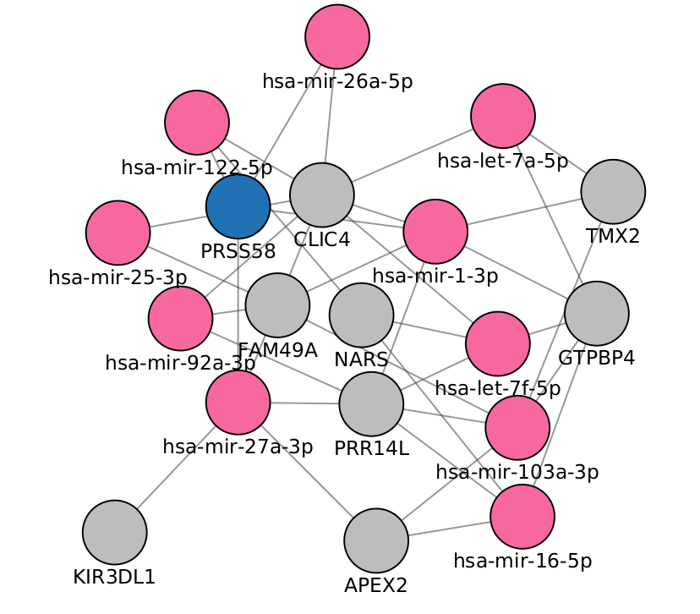

Slide 27







446 genes
2k miRNAs
3.5k edges
5 miRNAs
146 genes
163 edges
20 genes
446 genes
1.2k edges

Slide 28
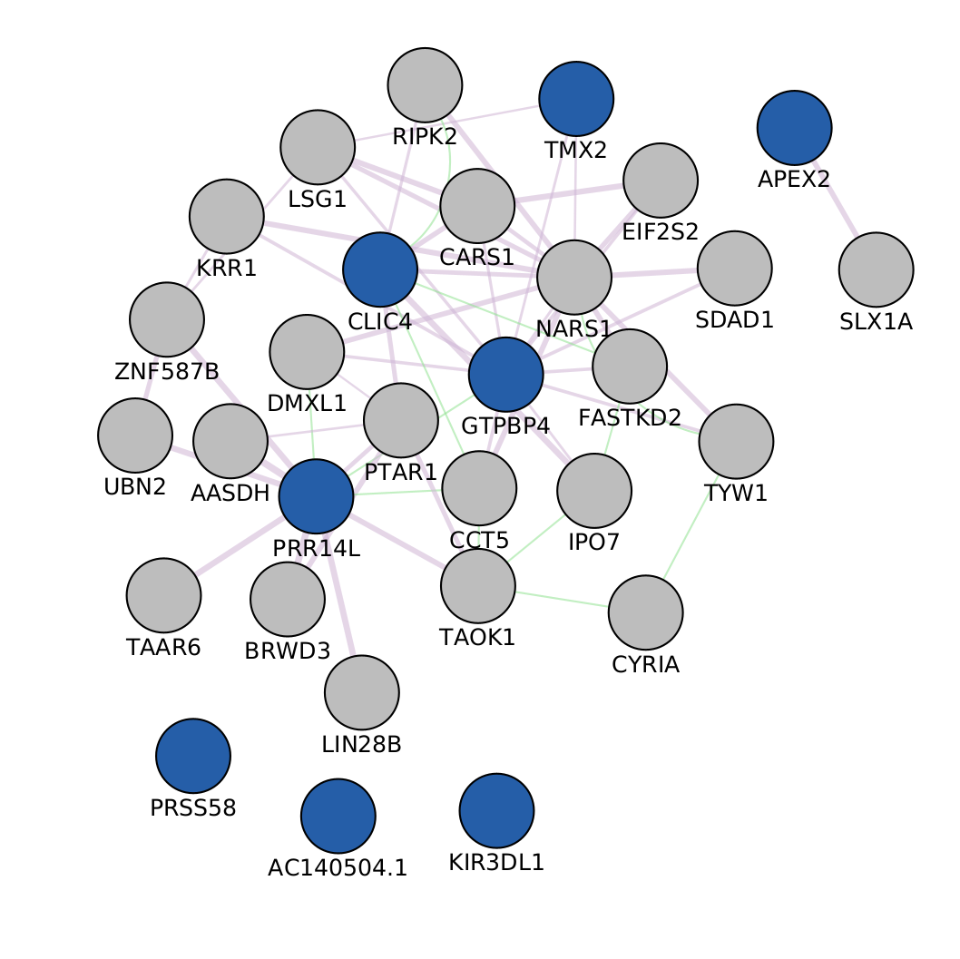

Slide 29
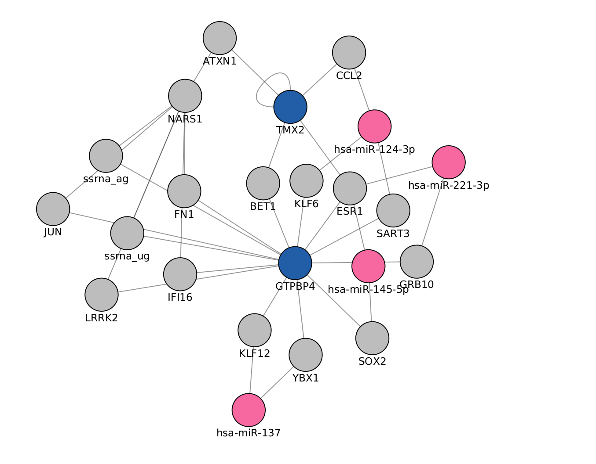

Slide 30
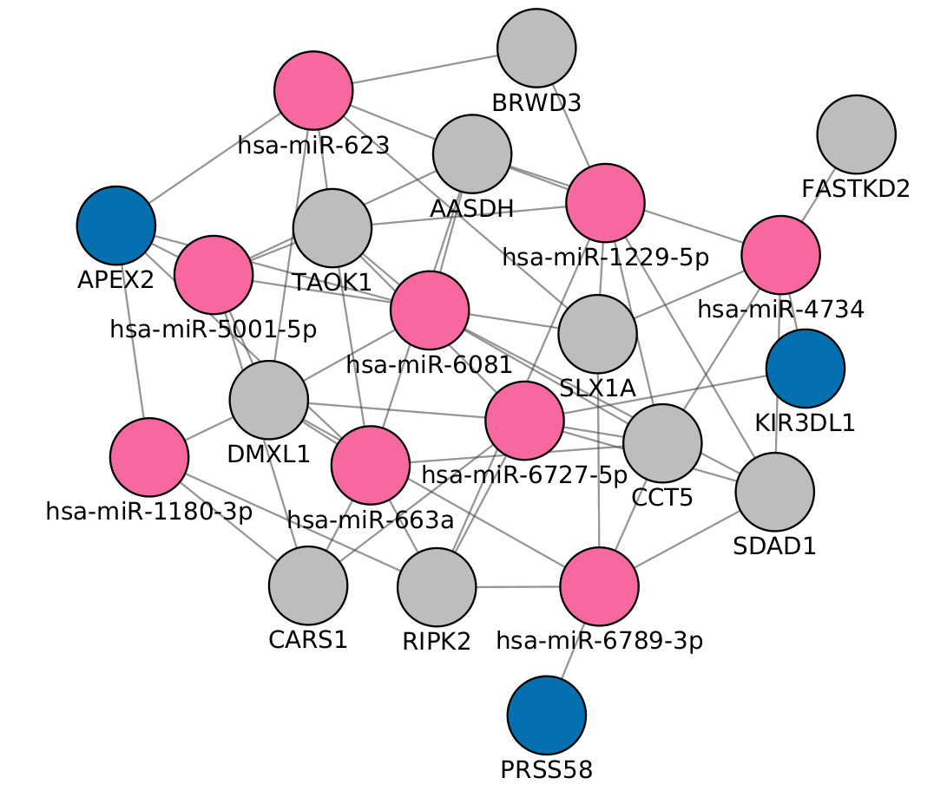

Slide 31
50% IntAct + Closeness centrality
20% mirNet
23%
GeneMania + PageRank
Differentially expressed?

Slide 32


Slide 33
Questions?
?

Slide 34
Thank You

Slide 35
Acknowledgements
This presentation has emanated from research conducted with the financial support of Science Foundation Ireland under Grant number [18/CRT/6214 ]

Slide 36


Slide 37
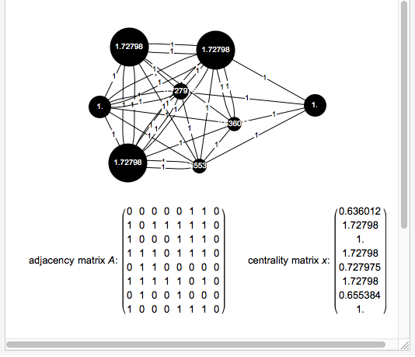

Slide 38
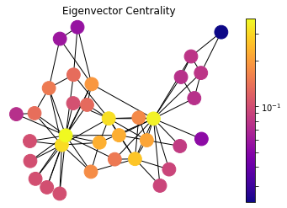
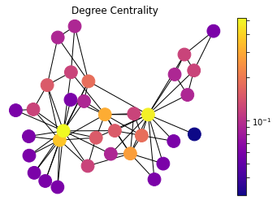
Centralities

Slide 39
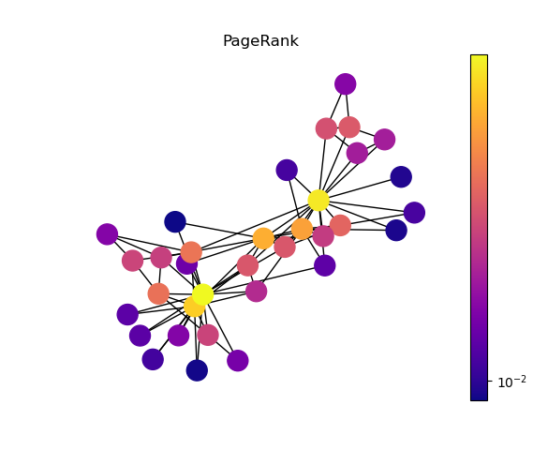
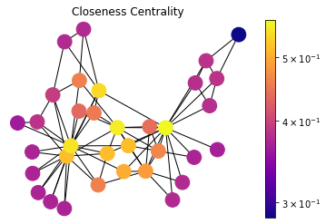
Centralities

Slide 40


Slide 41

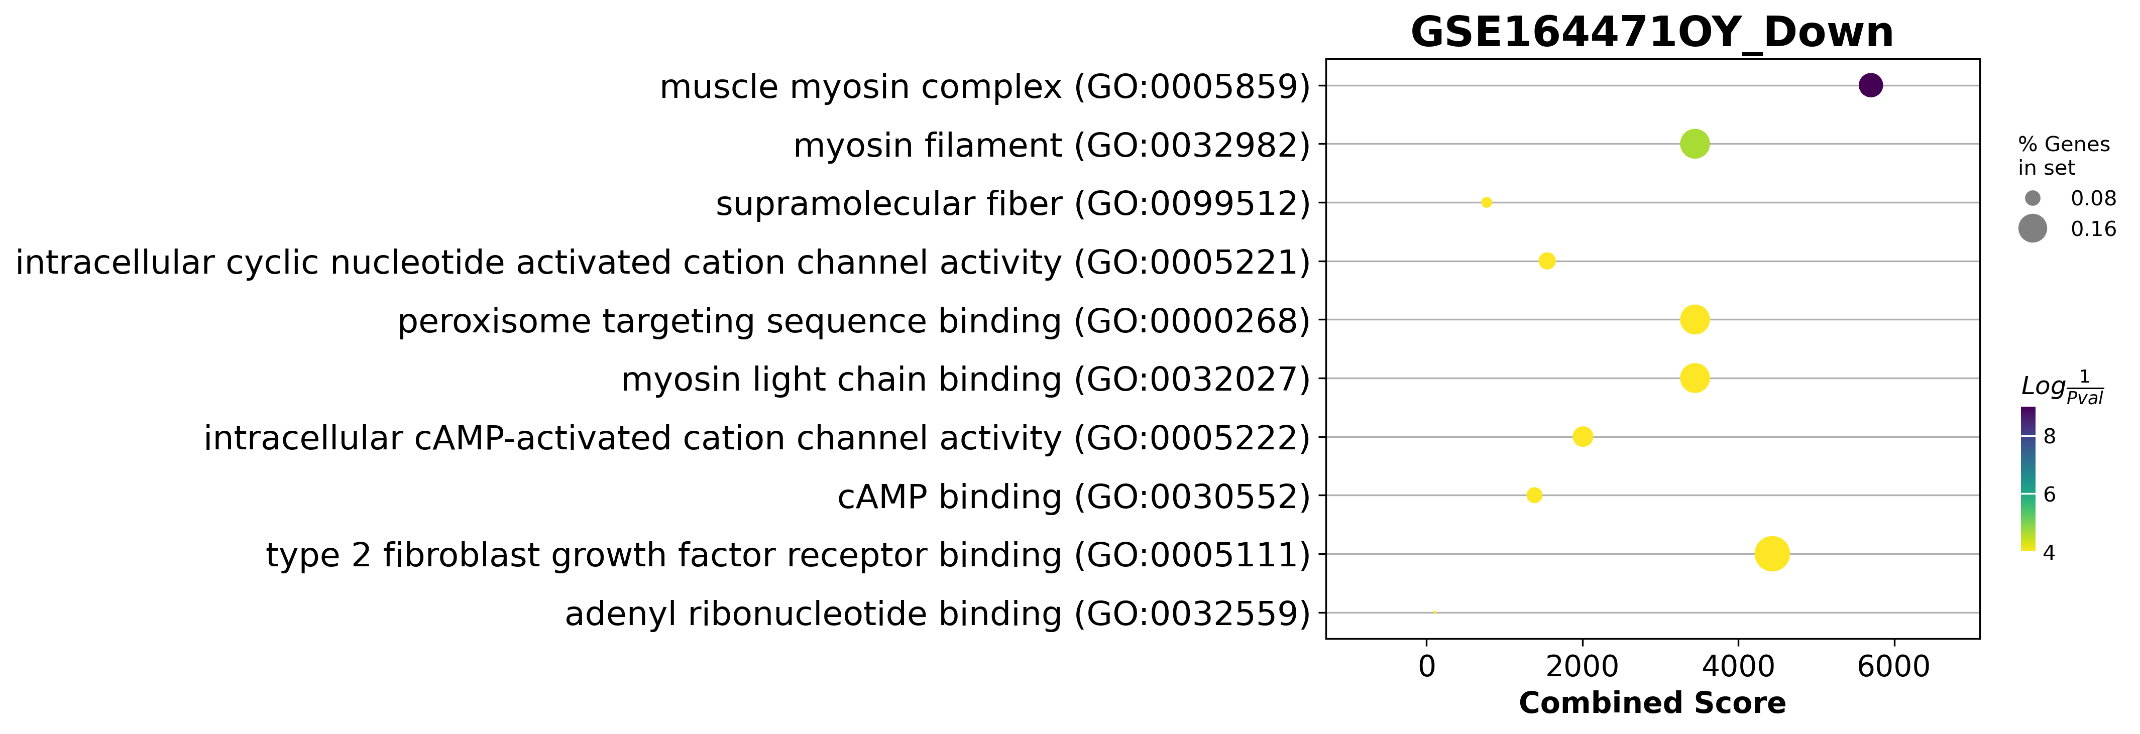
GSE164471 Dotplot

Slide 42
All comparisons (up or down)
MYH8
Young to Old
Young to Middle Age
2
1
8
0
1
MTCO1P12
4
MTND6P4
AC093809.1
12
MTND4P24
RPL10P9
Middle Age to Old

Slide 43
All comparisons (up)
Young to Old
Young to Middle Age
2
0
93
0
0
5
FAM96A
PAQR4
CISD1
FH
AIFM1
15
Middle Age to Old

Slide 44
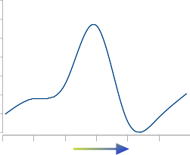
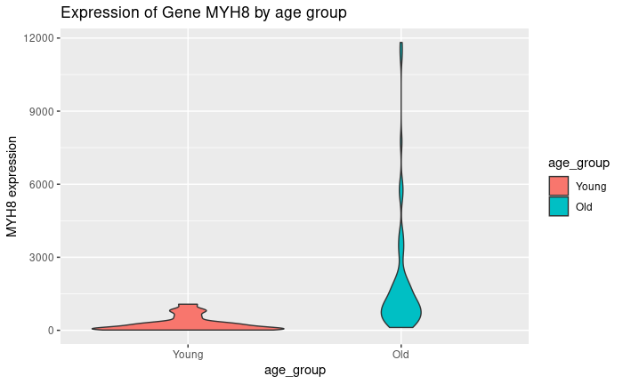
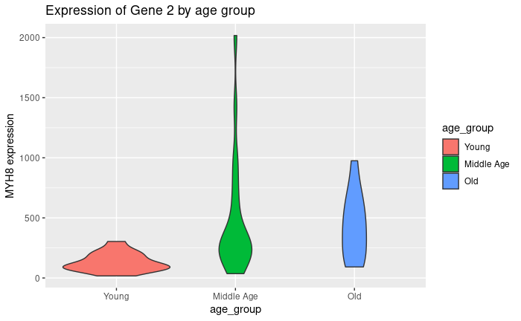
MYH8 raw count over age
Age
GSE157585
GSE164471

Slide 45
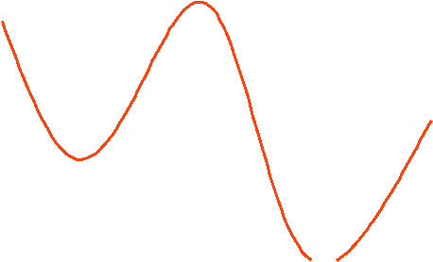
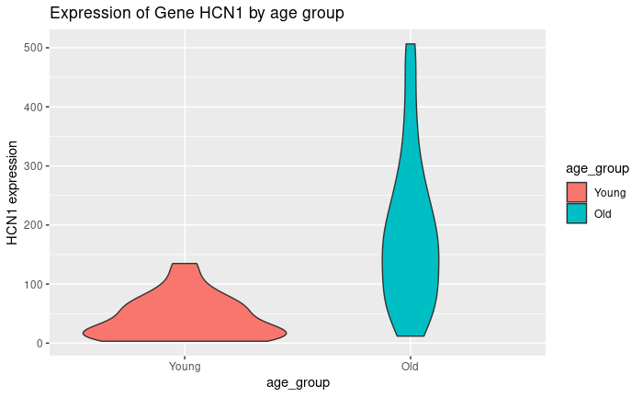
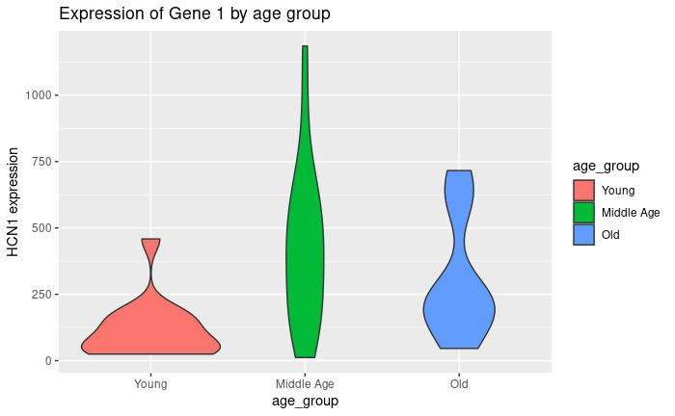
HCN1 raw count over age
GSE157585
GSE164471

Slide 46
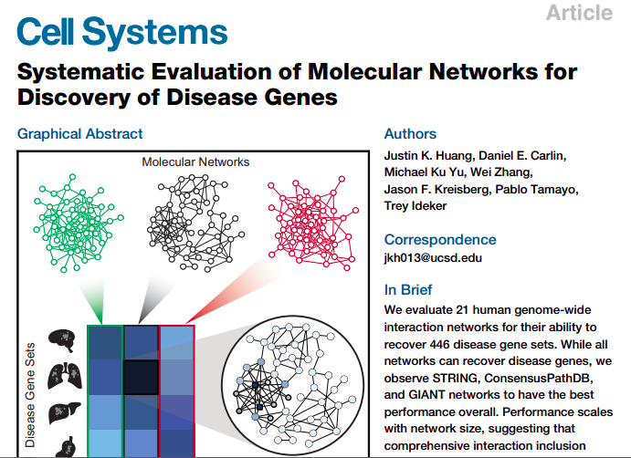

Slide 47
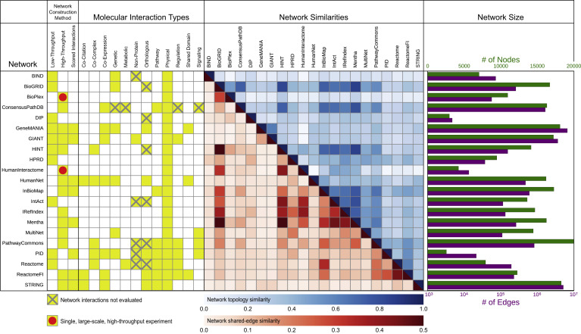

Slide 48
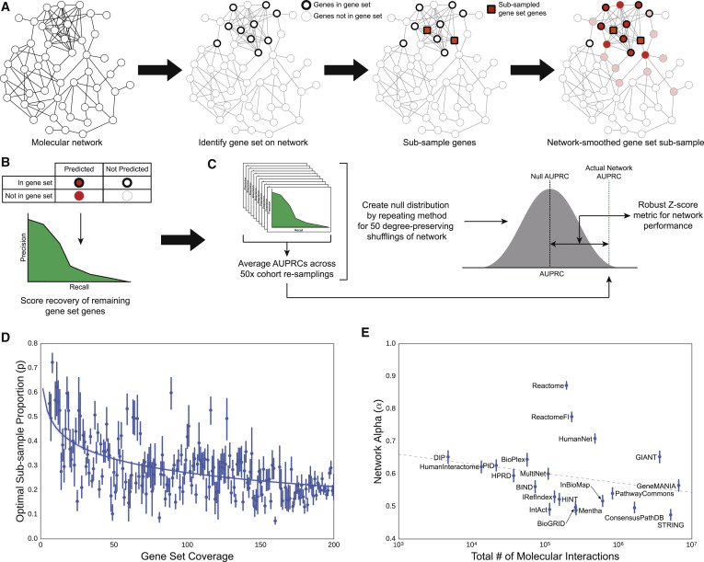

Slide 49
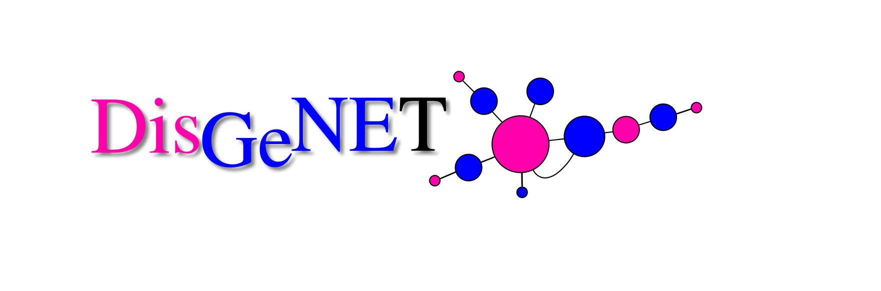

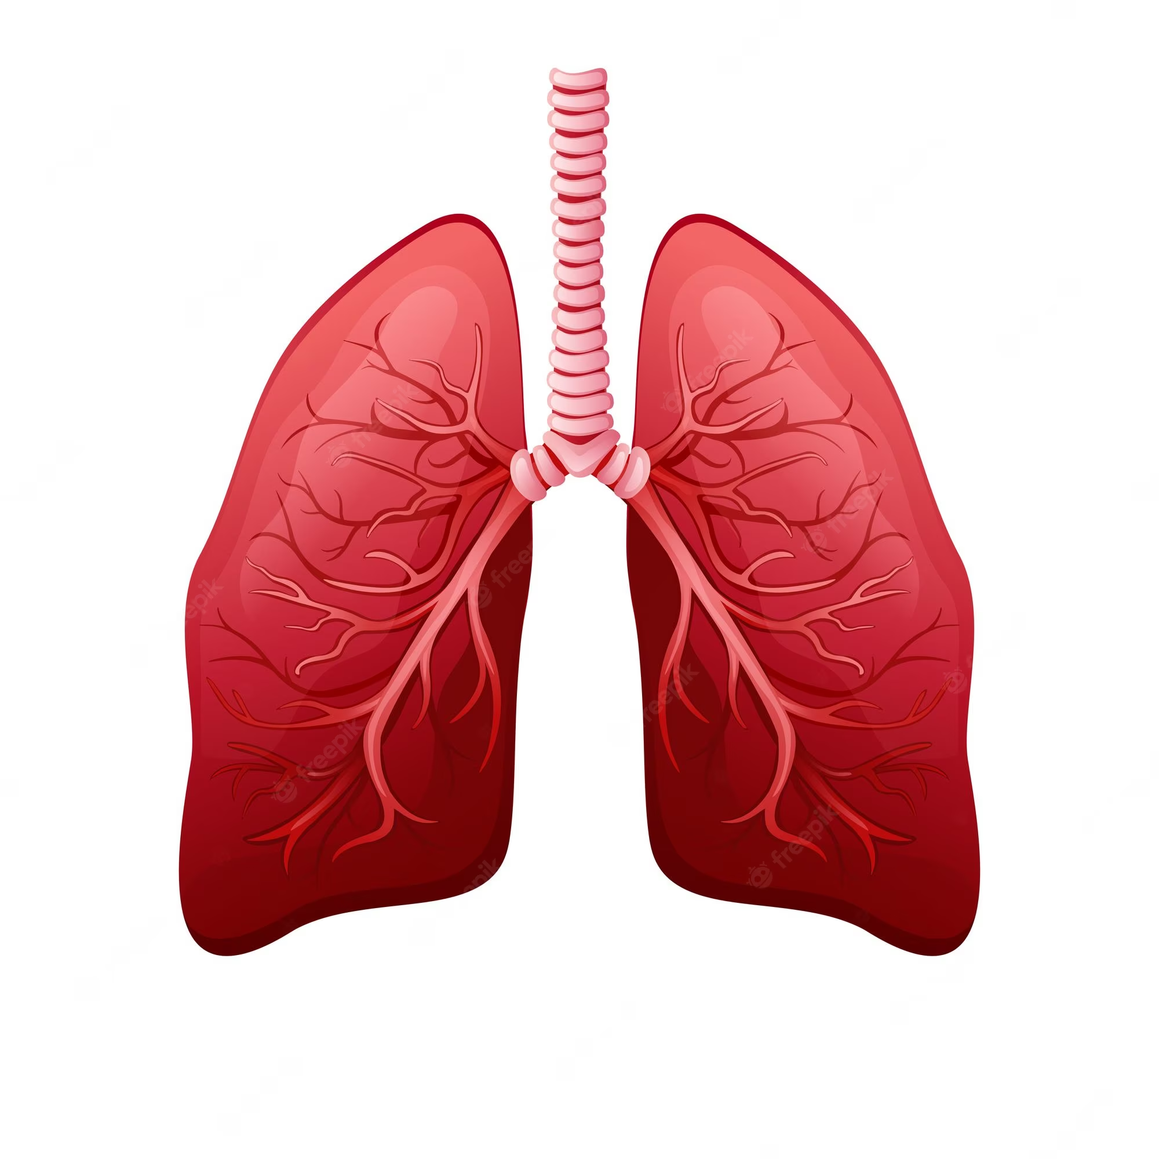
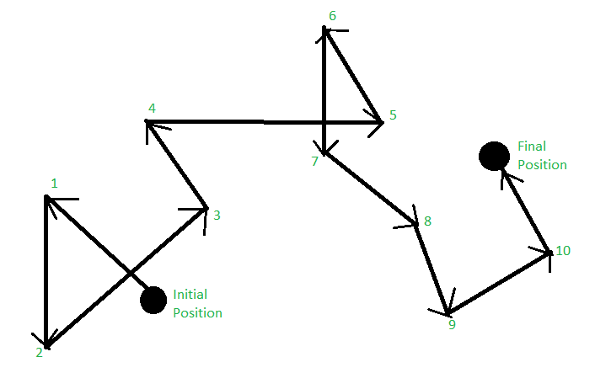
AUPRC

Slide 50
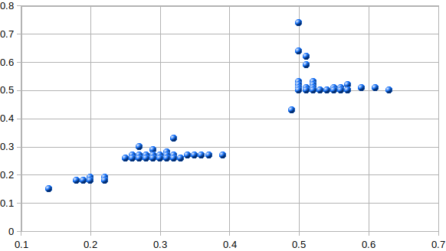
447 Diseases from DisGenNet
Edge Score
Hamman-Rich syndrome
Muscle related
Microcephaly
Node Score

Slide 51



Tools to analyze miRNAs

Slide 52
Tools to analyze miRNAs

Slide 53

Tools to analyze miRNAs

Slide 54
Tools to analyze miRNAs

Slide 55
Tools to analyze miRNAs

Slide 56
Tools to analyze miRNAs

Slide 57
Tools to analyze miRNAs

Slide 58
Tools to analyze miRNAs

Slide 59
Measuring and evaluating
Identify a gene set of interest on the molecular interaction network.
Sub-sample a proportion of the gene set of interest.
Propagate using the random walk model across the molecular interaction network.
Sort all genes in the network by propagation score and then sweep this list to calculate a precision-recall curve of the list for recovering genes from (1) not contained in (2).
Calculate the area under the precision-recall curve (AUPRC) from (4).
Repeat (2-5) for 50 different sub-samples of the gene set of interest and average these values. This averaged AUPRC is the raw measure of performance for a given molecular network on clustering a gene set of interest.
Repeat steps 1-6 for 50 degree-preserved shuffles of the network on the same gene set of interest to construct a null distribution of average AUPRC values.
Calculate the robust Z-statistic (Rousseeuw and Croux, 1993) using the null distribution of average AUPRC values from (7) of the actual network’s performance on the gene set of interest. This is the performance score of a network for a particular gene se

Slide 60
Next steps
Clean up the evaluation system
Define criteria for microRNA and gene selection
Select the microRNAs to send to the lab
Re run different configurations to find the best output
Work on the database

